Slide 1
Bazele inteligenței artificiale
Laborator – Grigore Ionuț

Slide 2


today’s lab

Slide 3


Slide 4
Content
The curse of dimensionality - intro
Principal component analysis (PCA)
Locally linear embedding (LLE)
t-Distributed stochastic neighbor embedding (t-SNE)

Slide 5
1) The curse of dimensionality

Slide 6

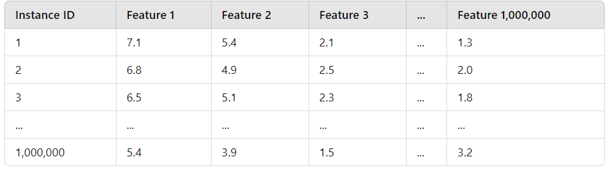
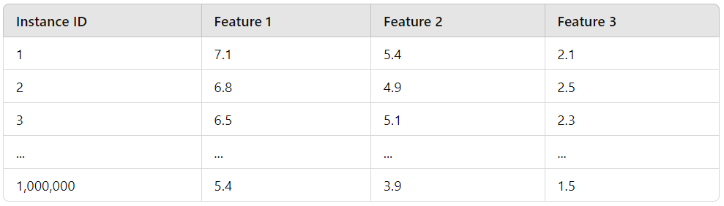
many machine learning problems involve thousands or even millions of features for each training instance
all these features
make training extremely slow
make it much harder to find a good solution
the curse of dimensionality !

Slide 7
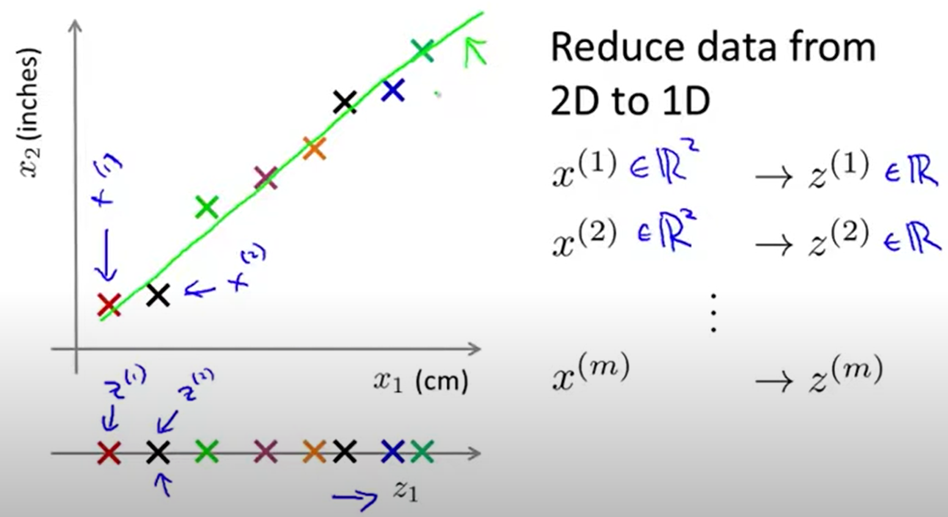
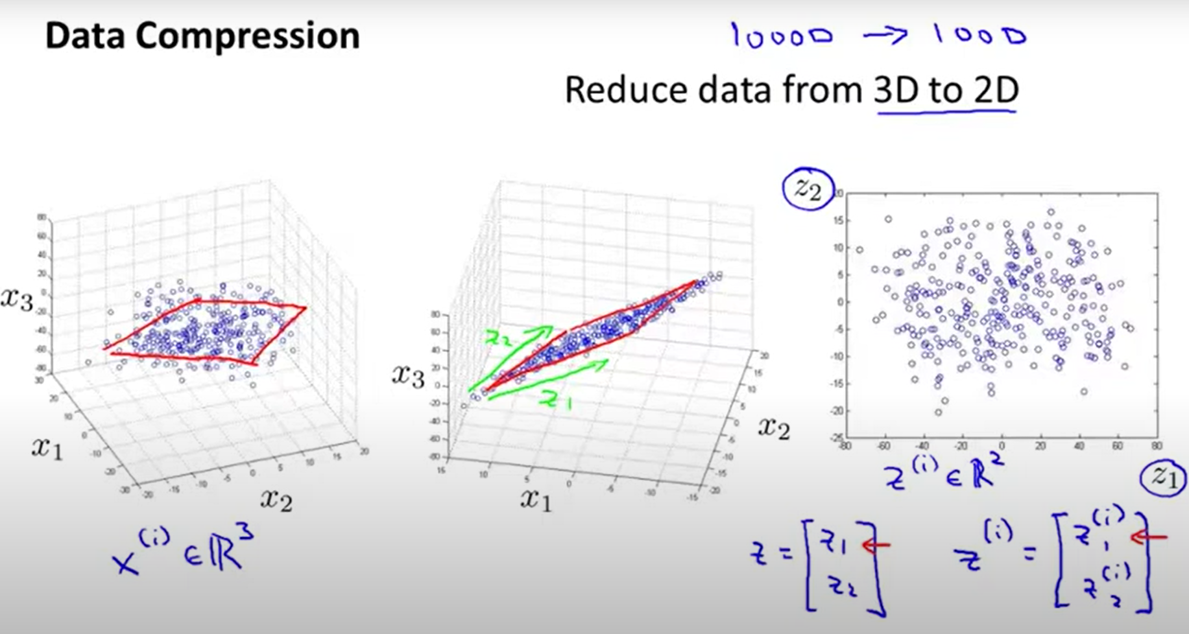




https://www.youtube.com/watch?v=pAwjiGkafbM

Slide 8
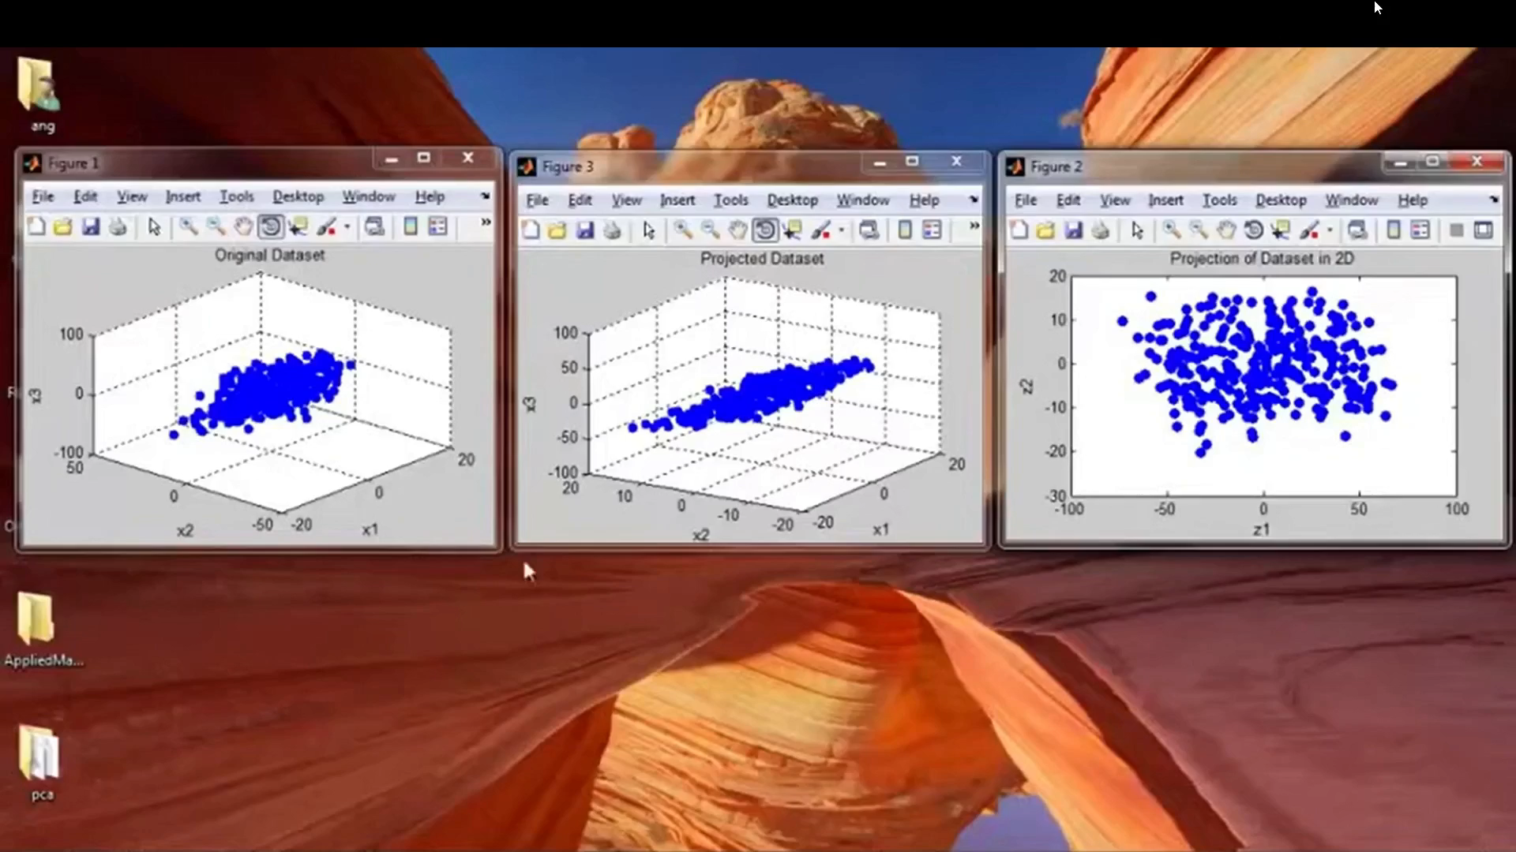

Slide 9


in real world problems it’s often possible to reduce the number of features considerably:
Analogy:
Like summarizing a 100-page book into 1 page — you lose details, but keep the essence.
some information loss a slightly worse performance
speed up training
data visualization reducing the number of dimensions to 2 or 3 we can plot the data and gain some insights about the it

Slide 10
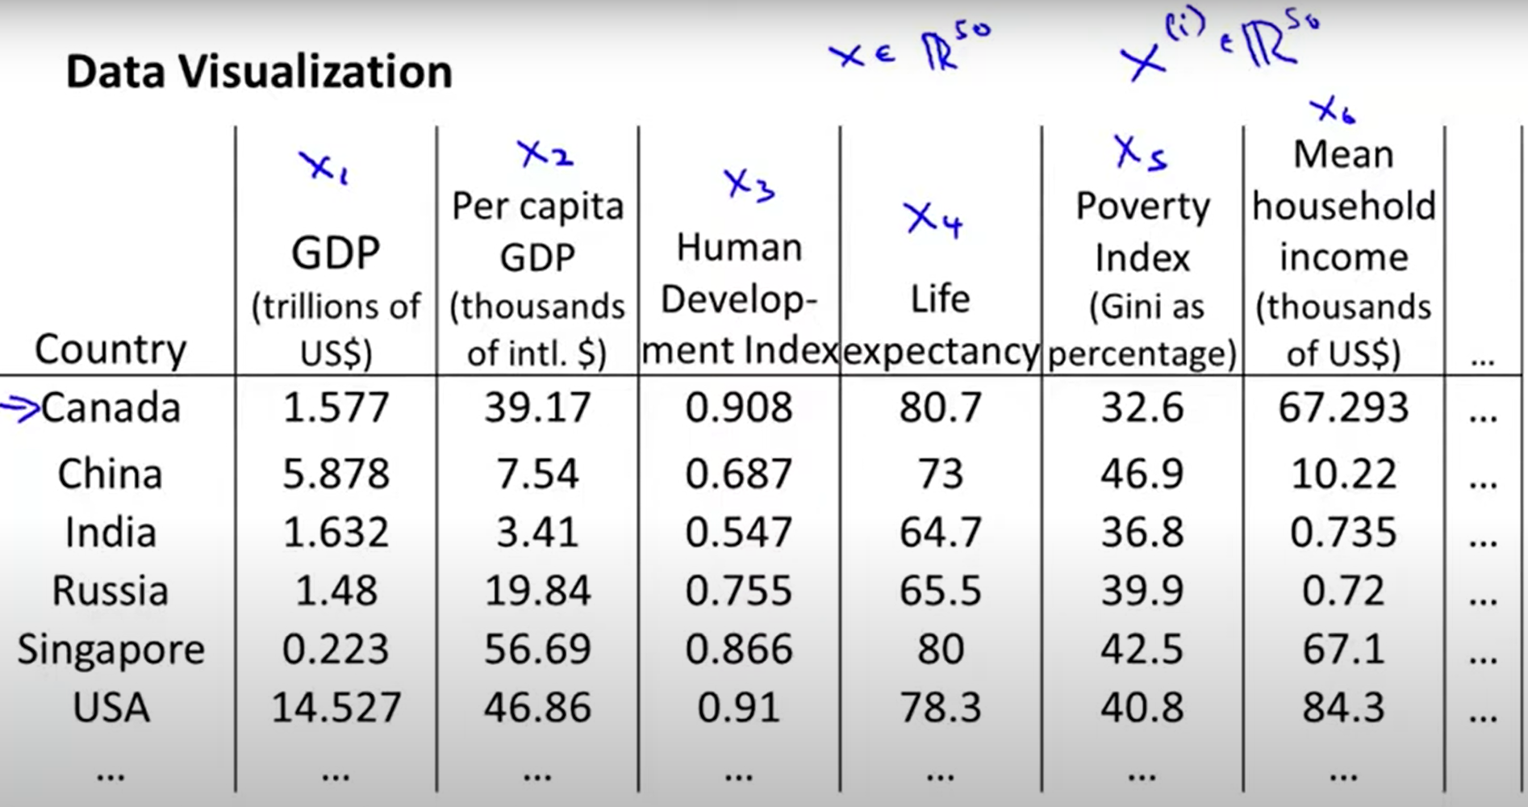
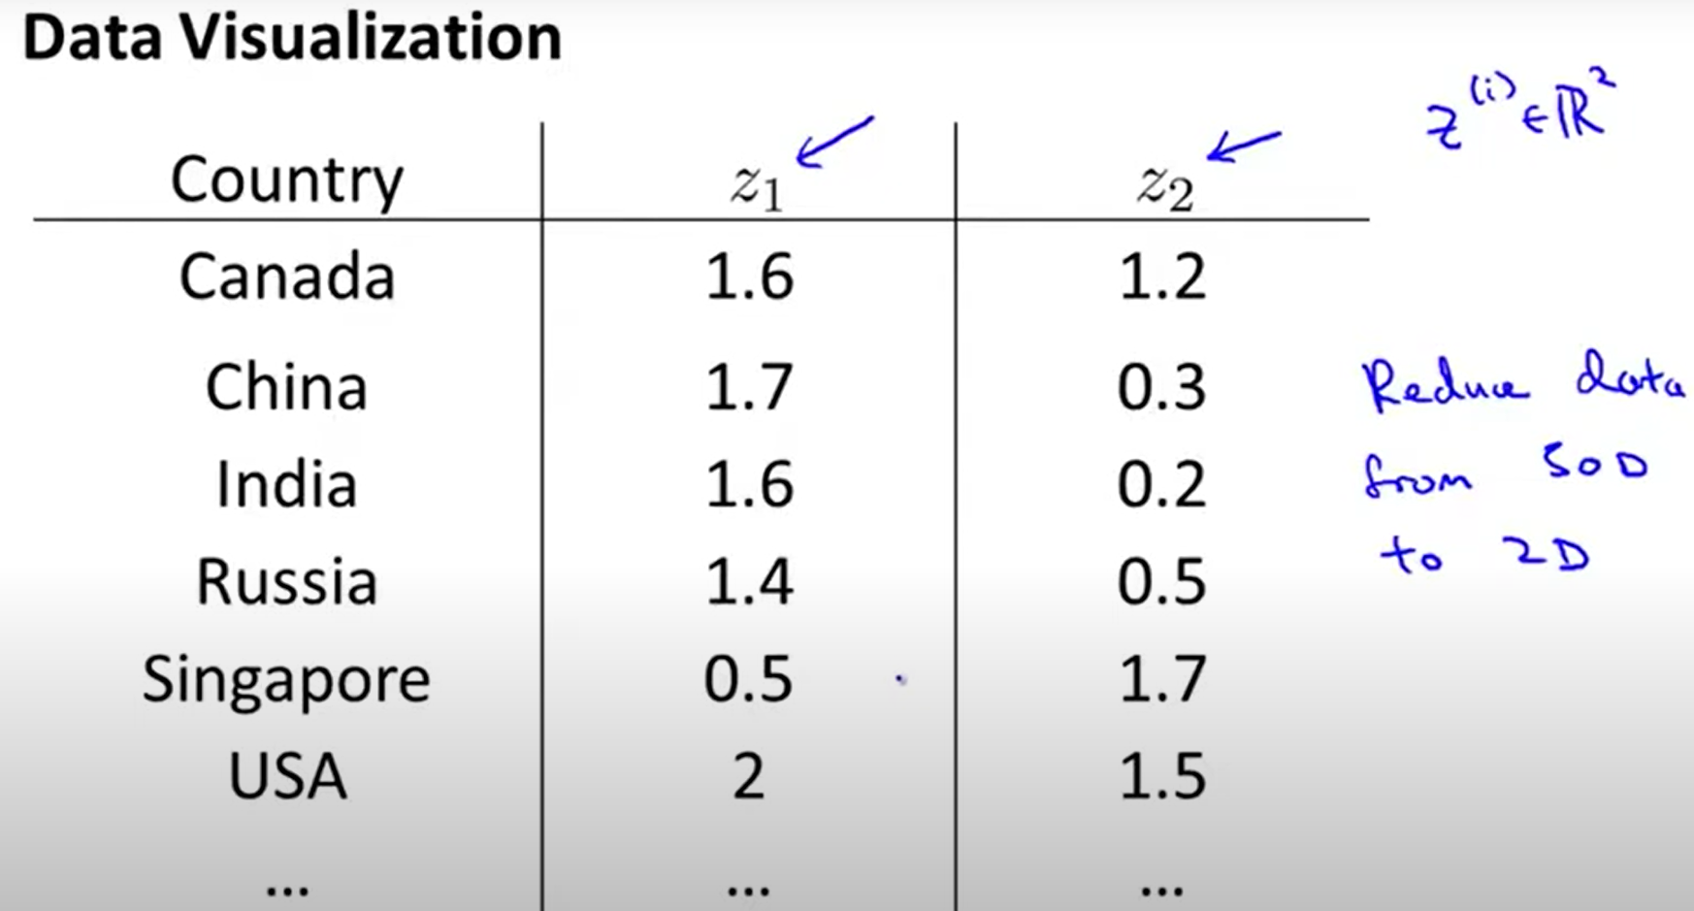
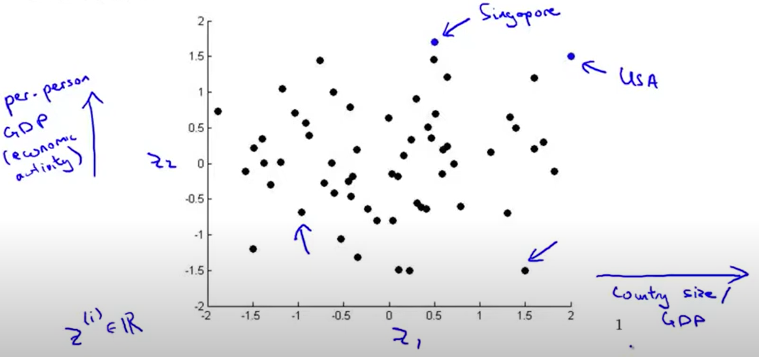
NOTE:
the dimensionality reduction algorithm usually doesn’t describe a particular meaning to these new features z₁ and z₂
it’s often up to us to figure out roughly what these features means
we might find for example that the z₁ axis corresponds roughly to the overall country size or the overall economic activity (GDP) whereas the z₂ axis may correspond to per person economic activity

Slide 11
2) Principal component analysis (PCA)

Slide 12
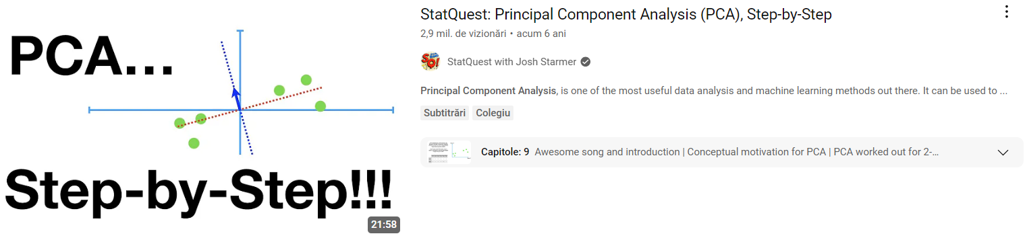
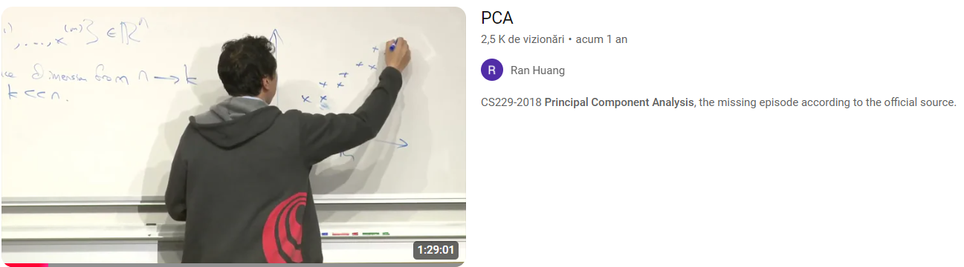

Slide 13
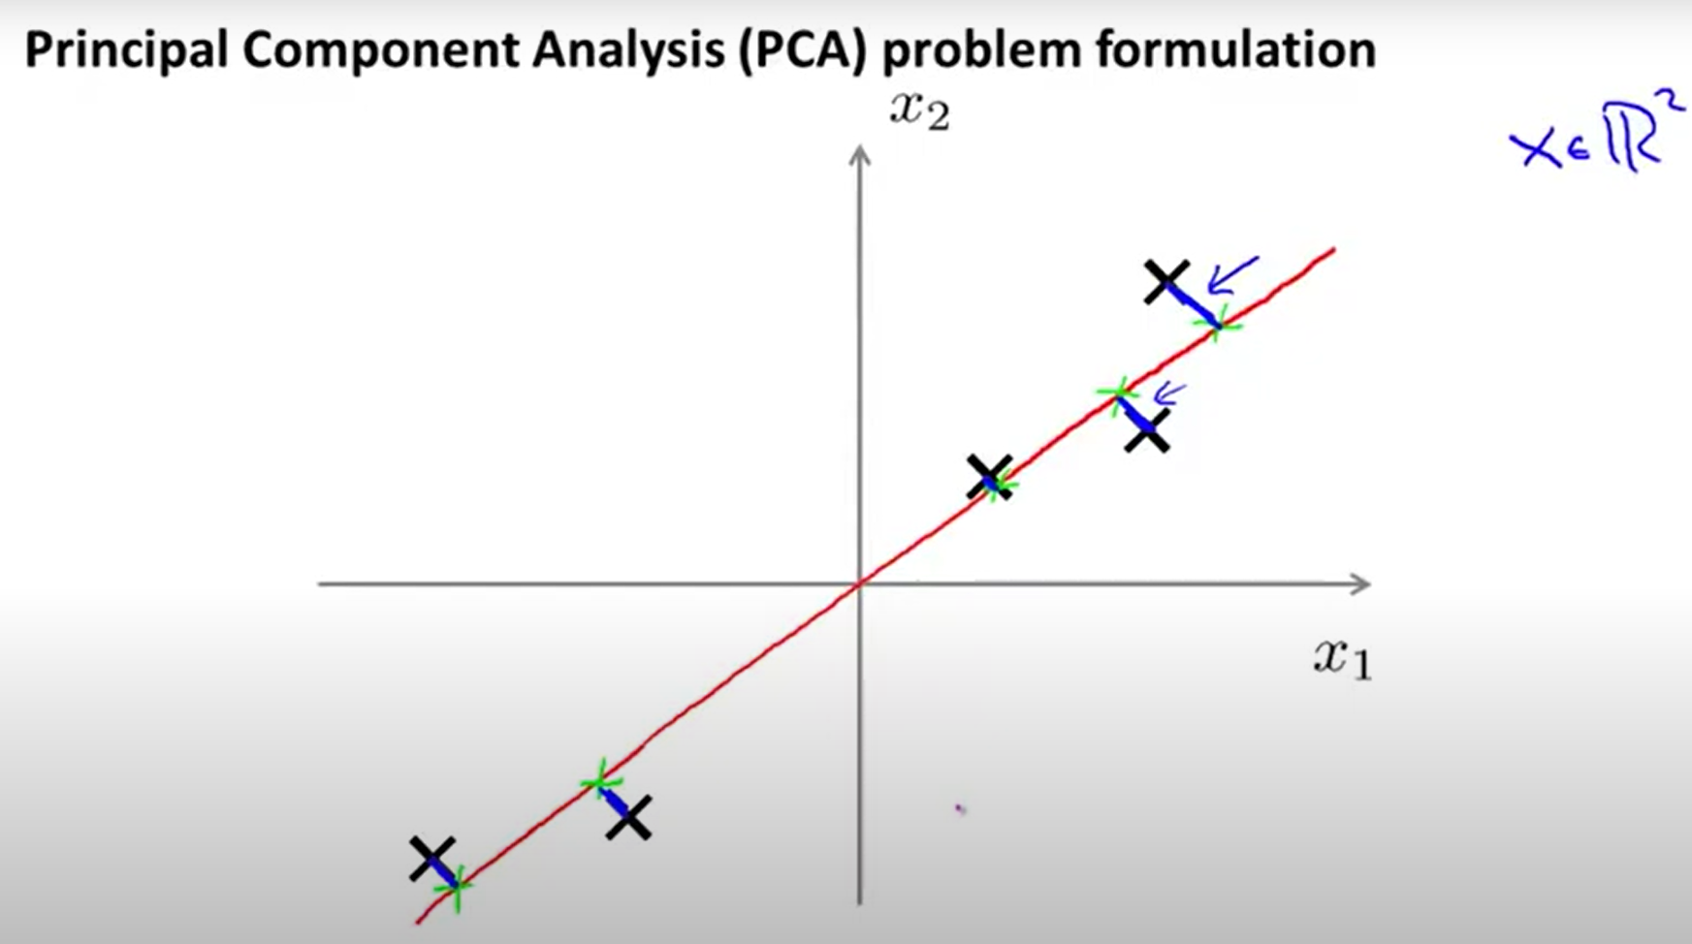
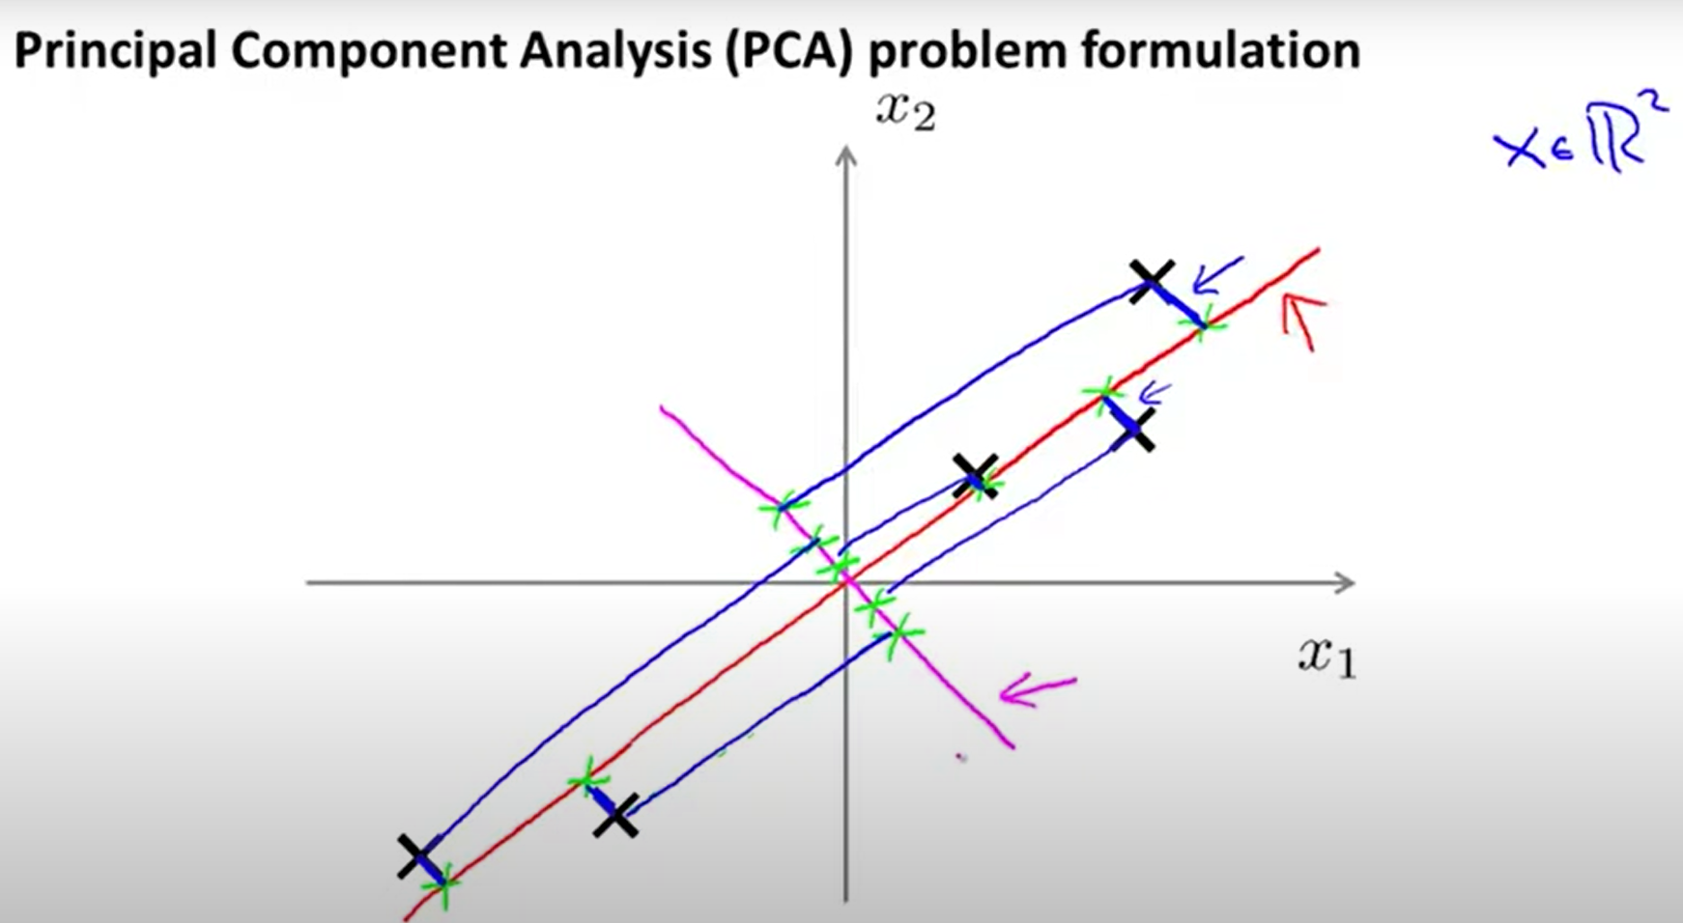
GENERAL IDEA: identify the hyperplane that lies closest to the data and then projects the data onto it
NOTE: before we can project the training set onto a lower-dimensional hyperplane, we first need to choose THE RIGHT HYPERPLANE !
red line
magenta line

Slide 14
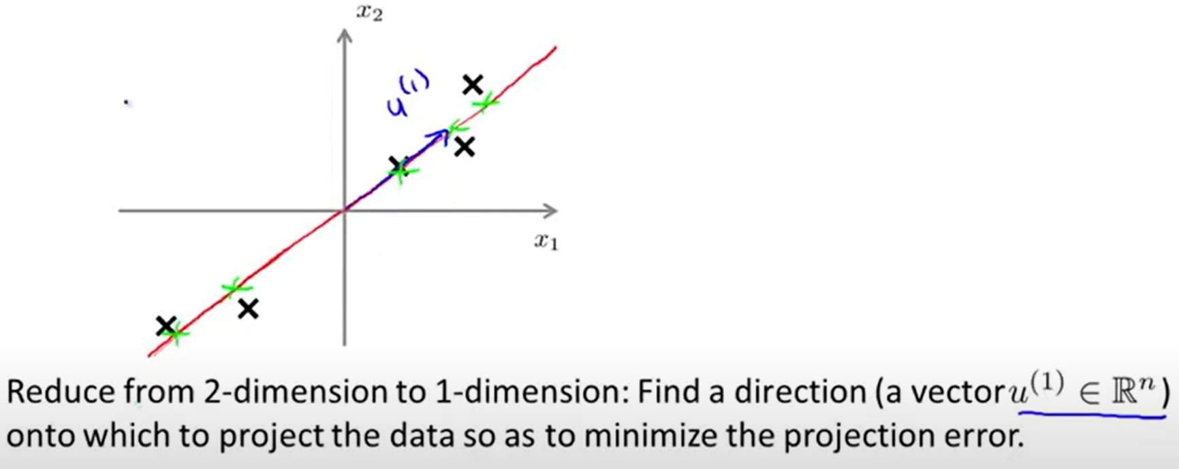

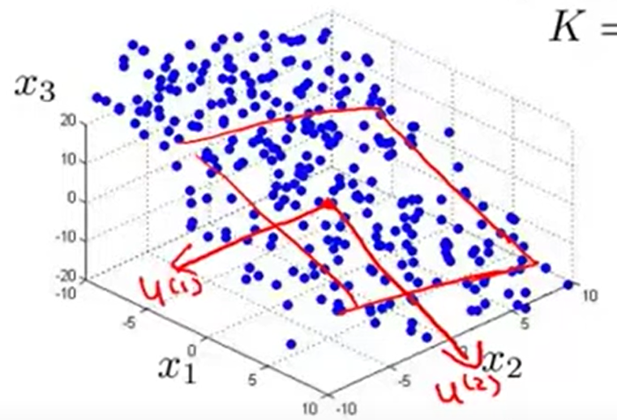

3

Slide 15
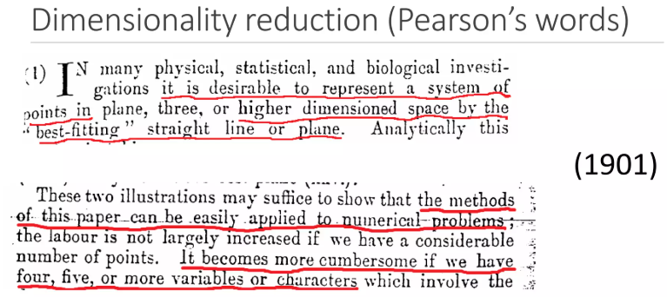
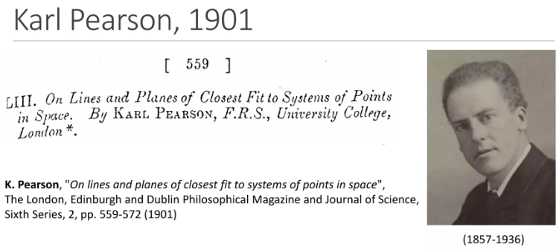
PCA finds new axes (called principal components) that capture the maximum variance in the data
How it works:
The first principal component points in the direction of highest variance.
Each subsequent component is orthogonal (perpendicular) to the previous ones and captures the next highest variance.
These components form a new coordinate system that better reveals the structure of the data.
Analogy: Imagine rotating the coordinate system to “see” the data from its most informative angle.
Fun fact: PCA was invented over 100 years ago — still one of the most used tools in AI today!

Slide 16

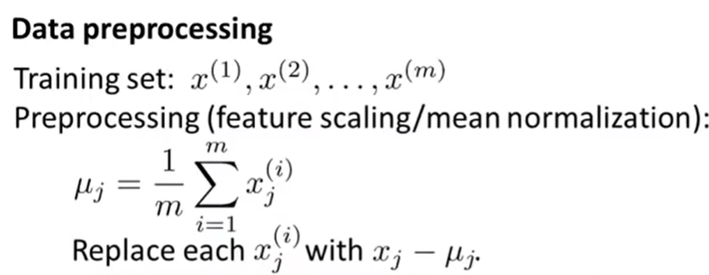
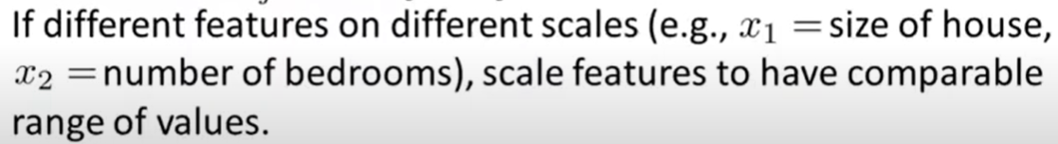
PCA Steps
https://www.youtube.com/watch?v=pAwjiGkafbM
1)
WHY ?

Slide 17
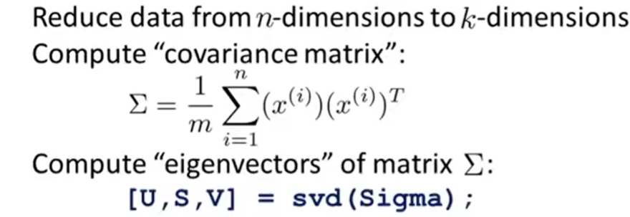
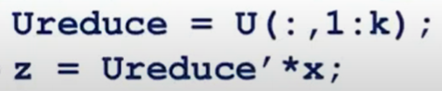



https://www.youtube.com/watch?v=pAwjiGkafbM
2)
1 x n
n x 1
3)
n x n
4)
5)

Slide 18
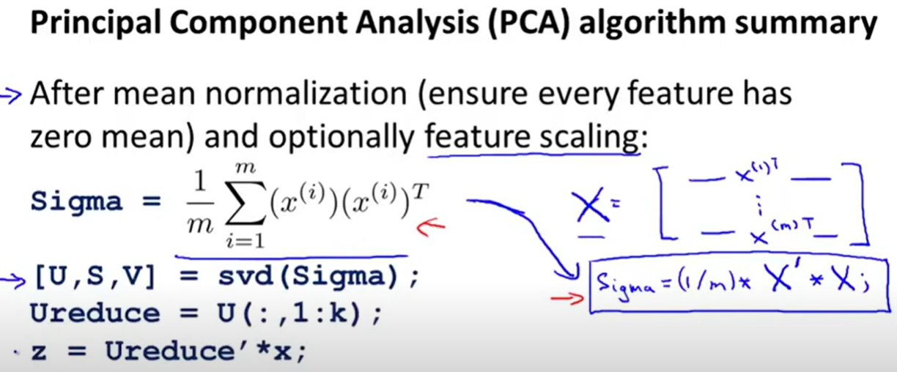


https://www.youtube.com/watch?v=pAwjiGkafbM
.

Slide 19
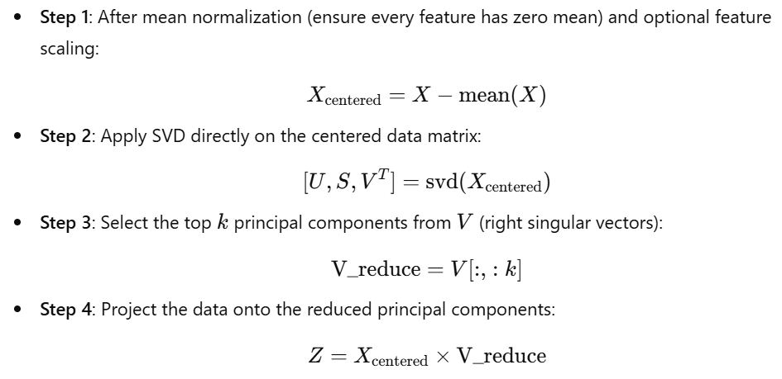




- alternative variant used in the code part -

Slide 20


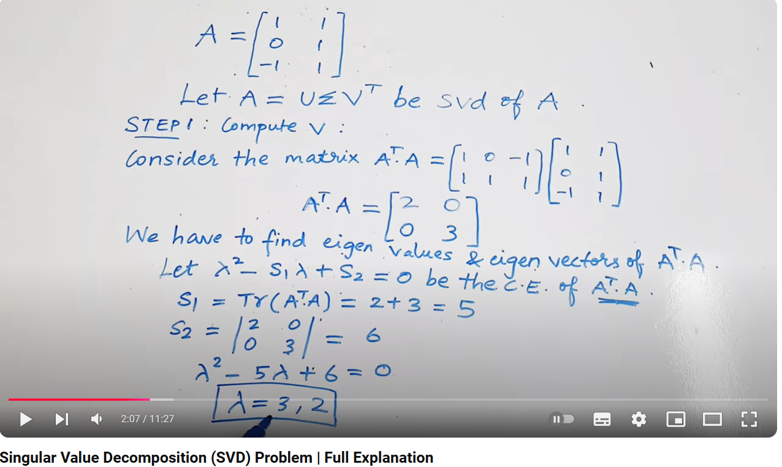

What is SVD?
https://medium.com/intuition/singular-value-decomposition-svd-working-example-c2b6135673b5

Slide 21
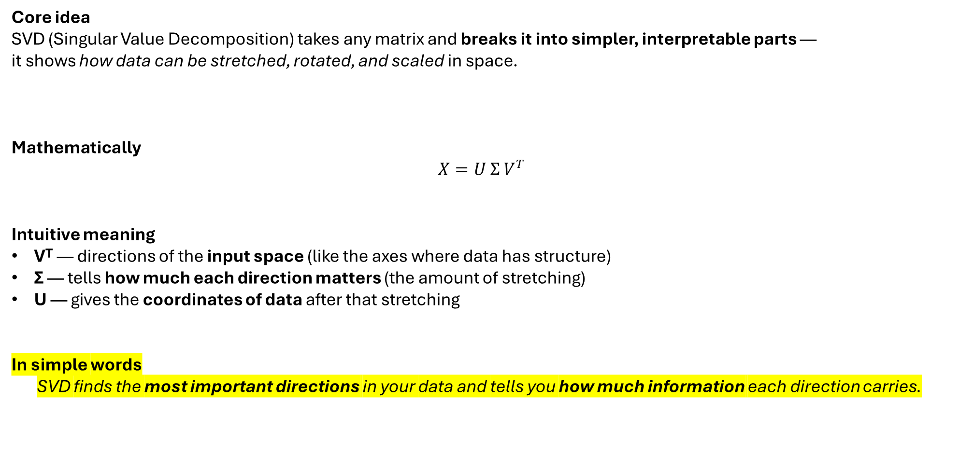
What SVD Really Does (Intuition)
Core idea
SVD (Singular Value Decomposition) takes any matrix and breaks it into simpler, interpretable parts —
it shows how data can be stretched, rotated, and scaled in space.
Mathematically
$$X=U Σ V^{T}$$
Intuitive meaning
Vᵀ — directions of the input space (like the axes where data has structure)
Σ — tells how much each direction matters (the amount of stretching)
U — gives the coordinates of data after that stretching
In simple words
SVD finds the most important directions in your data and tells you how much information each direction carries.

Slide 22
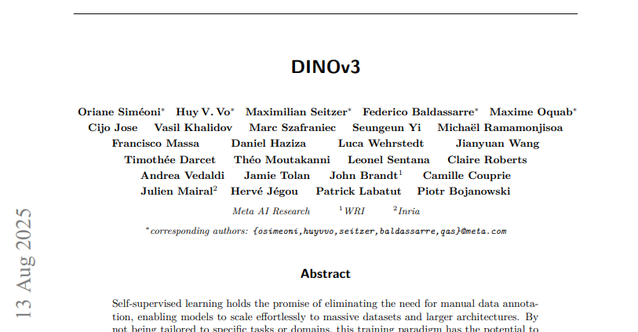
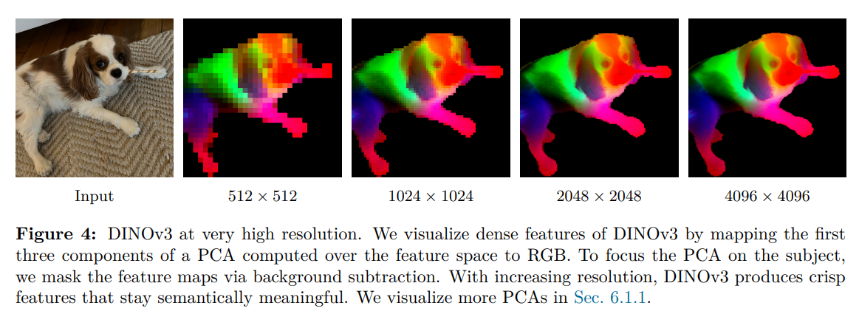


DINOv3 is a new special self-supervised model that learns image features without labels released by Meta
Each pixel in the image has a feature vector (hundreds of values) describing what the model “sees”
These feature vectors live in a high-dimensional space — impossible to visualize directly
PCA reduces these high-dimensional pixel features to just 3 components
The 3 principal components are mapped to RGB colors
Similar colors = pixels that the network considers semantically similar
This lets us see how the model internally organizes the image
PCA makes the model’s feature space visible —
it helps researchers interpret, debug, and trust how AI “understands” images.

Slide 23
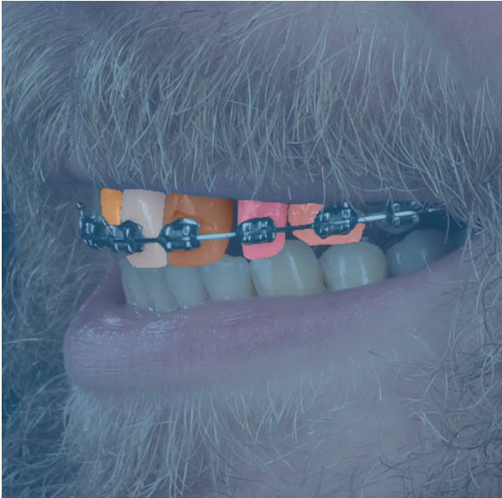
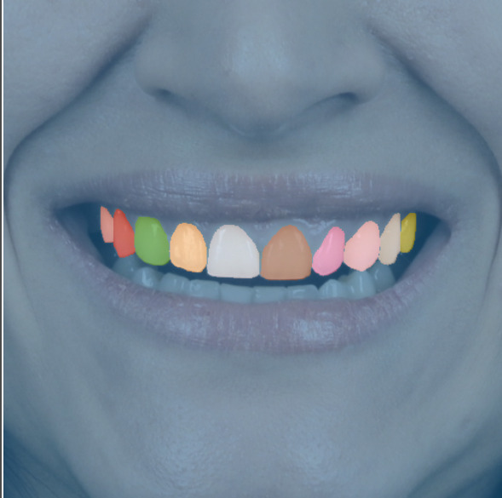
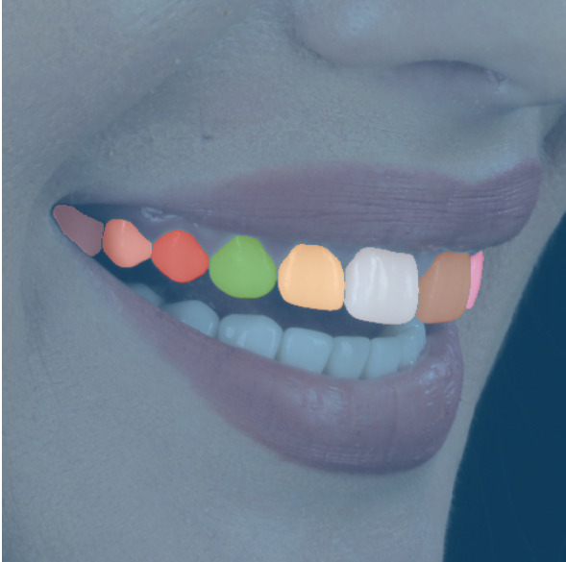


At my current job, we leverage DINOv3 to segment teeth in smile images.
Each pixel in the image has a high-dimensional feature vector that encodes semantic meaning.
Using PCA, we can project these features into 3D RGB space to visualize what DINO “understands” about the image.
Left & Middle: DINO correctly segments individual teeth with distinct PCA colors.
Right: Remarkably, tooth 16 (unlabeled in the ground truth) is still detected by DINO —
PCA visualization exposes that the model internally recognizes this tooth region.

Slide 24
Code part

Slide 25
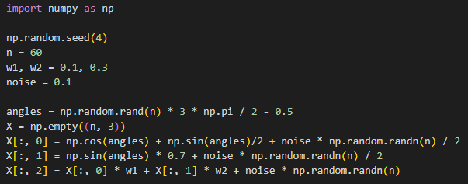
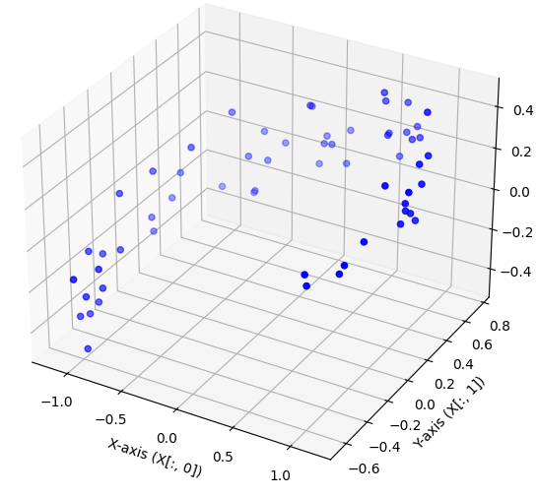
Our 3D dataset:
Z-axis (X[:, 2])

Slide 26


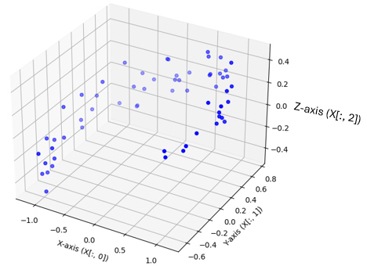
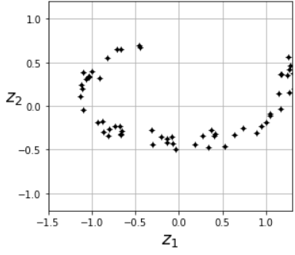




feature scaling/mean normalization:
apply SVD (single value decomposition):
extract the 2 unit vectors that define the first 2 PCs :
obtain the reduced dataset:
X2D_using_svd
X

Slide 27
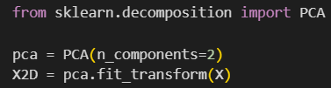

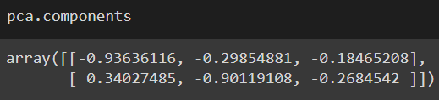

…or in a simpler way…
the same with previous X2D_using_svd
this is how we can see the components computed by PCA:

Slide 28



^
we can transform the data back to the original space, obtaining X:
of course, there was some loss of information during the projection step, so the recovered 3D points are not exactly equal to the original 3D points:
reconstruction error

Slide 29
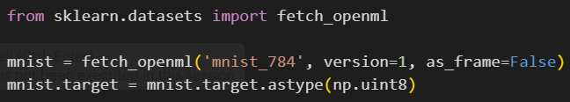
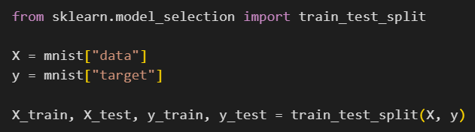

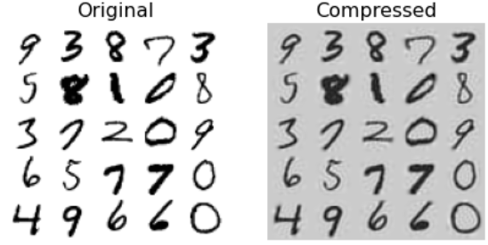

X_train
X_recovered
plot_digits() function from the lab

Slide 30
3) Locally linear embedding (LLE)

Slide 31
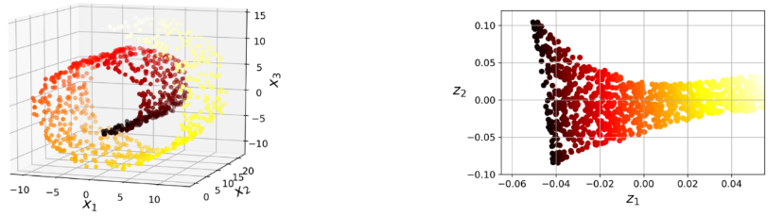
Swiss roll dataset
Unroleld Swiss roll
it’s a manifold learning algorithm it’s used for datasets like Swiss roll
in a nutshell, LLE works by:
      1) measuring how each training instance linearly relates to it closest neighbors
      2) looking for a low-dimensional representation of the training set where these local relationships are best preserved

Slide 32
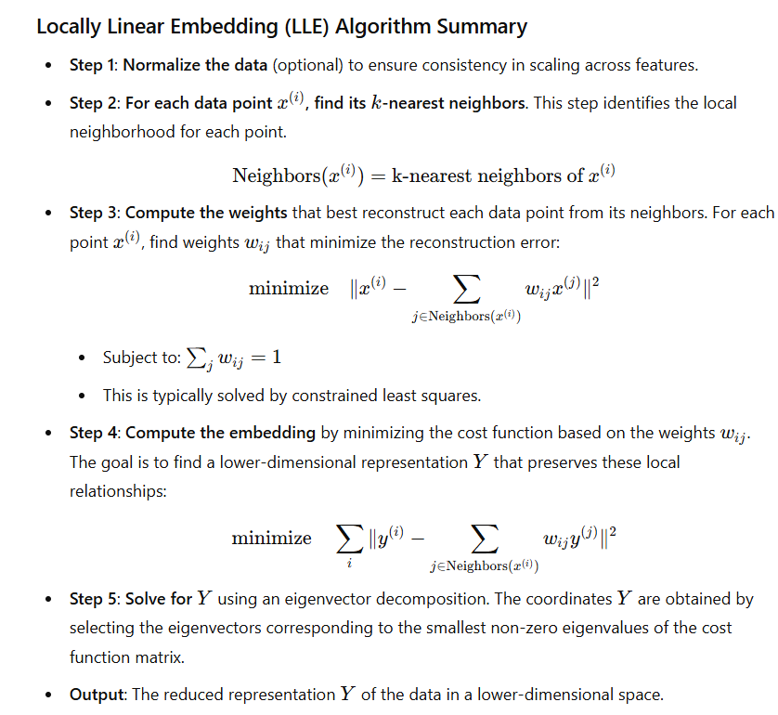

Don’t worry about it ☺

Slide 33
Code part

Slide 34

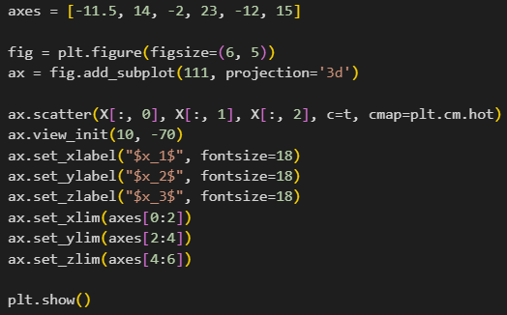
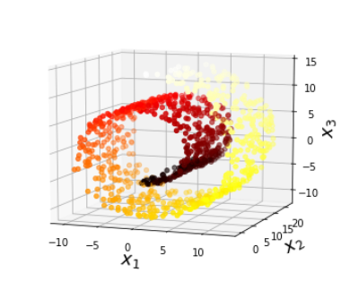

Slide 35

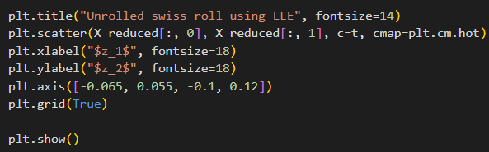
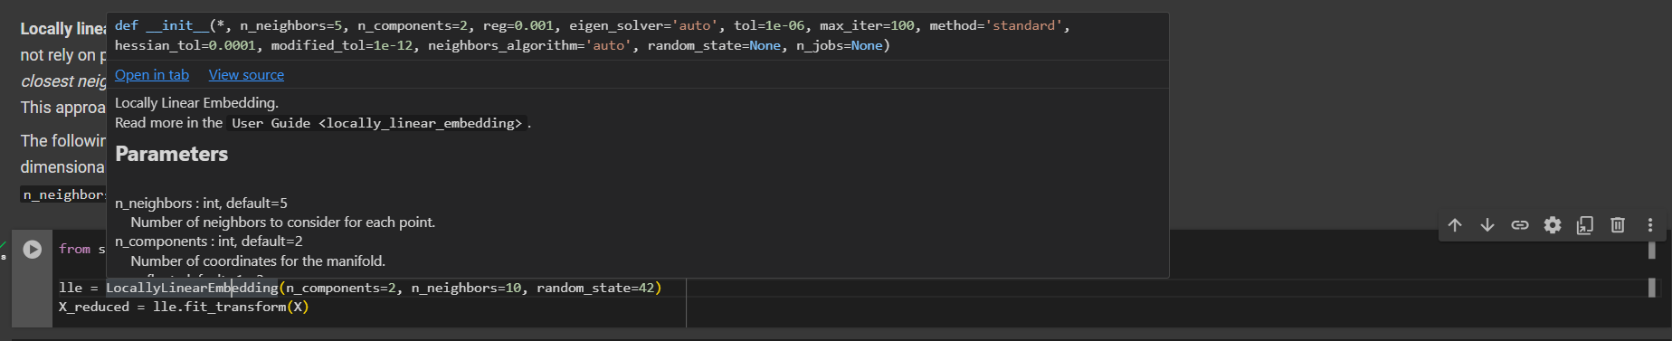
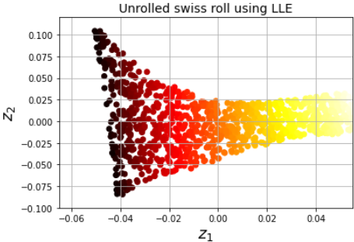



don’t worry about them ☺
KIND REMINDER

Slide 36
4) t-Distributed stochastic neighbor embedding (t-SNE)

Slide 37
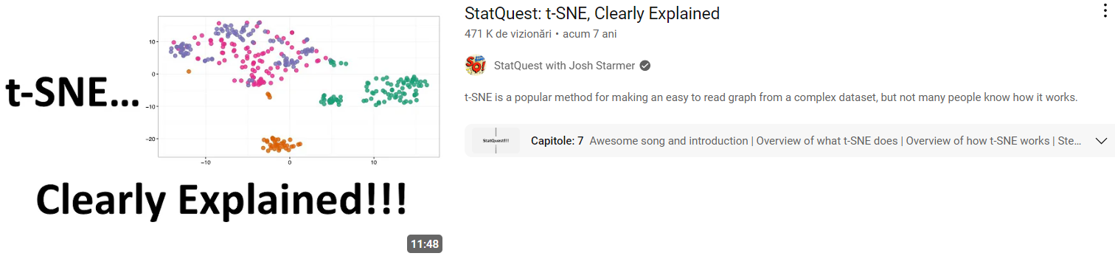

Slide 38
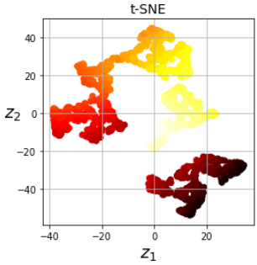
t-SNE reduces dimensionality while trying to keep similar instances close and dissimilar instances apart
it’s very good for visualizing clusters of instances in high-dimensional space

Slide 39
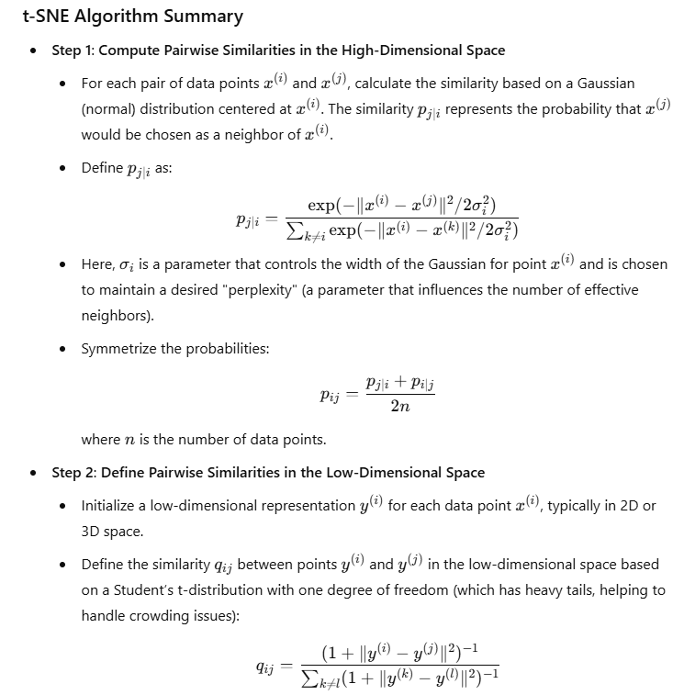
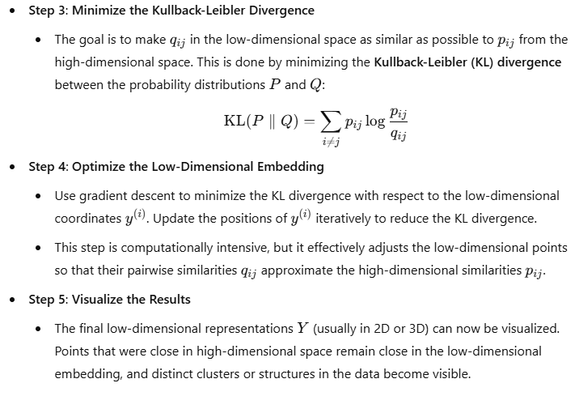

Again, don’t worry about it ☺

Slide 40
Code part

Slide 42

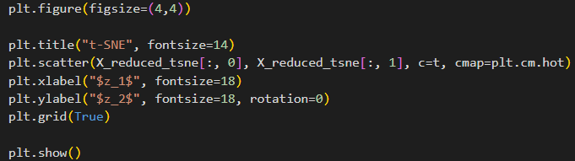


Slide 43




Slide 44






PCA
t-SNE

Slide 45
Conclusion from the previous slide? t-SNE reduces dimensionality while also helps for clustering !

Slide 46
Exercises

Slide 47


Slide 48





Solutions

Slide 49



Slide 50




Slide 51



Slide 52


Slide 53
Thank you !

